Slide 1
Java Lecture 3

Slide 2
Introduction to Java part 3
Advantages of java
  Simple
  Object Oriented
  Network-Savvy
  Robust
  Secure
  Portable
  Multithreaded
  Dynamic
  Interpretated
  Architecture Neutral

Slide 3
Java Basics
Input function in java
  Syntax of BufferedReader
    BufferedReader varaible name =new BufferedReader(new InputStreamReader(System.in));
  Syntax for use
    Varaible name.readLine(); //whole line
  Use java.io package and throws Exception.

Slide 4
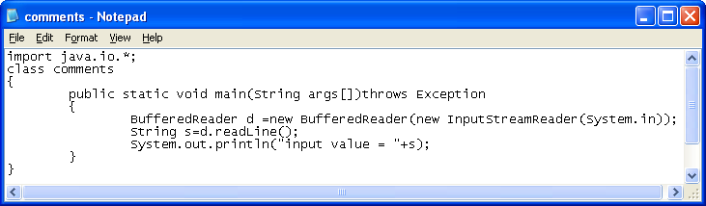
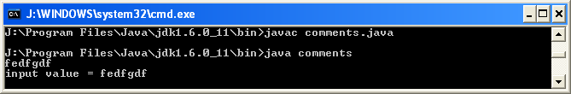
Java Basics
Input function in java Example

Slide 5
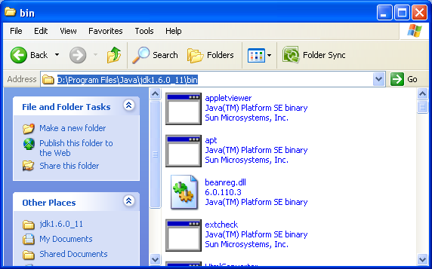
Java Basics
Setting the path.
  To run program anywhere in any directory
  Step 1:Copy the path to bin

Slide 6
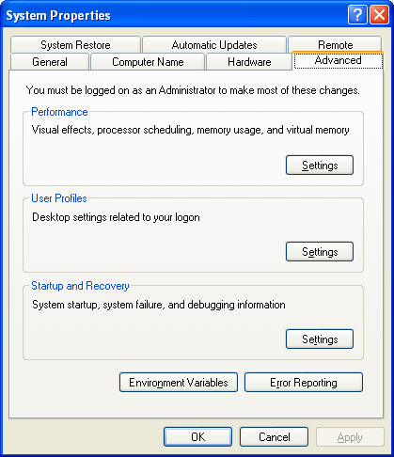
Java Basics
Setting the path.
  Step 2:
  Go to system
  property and advance

Slide 7
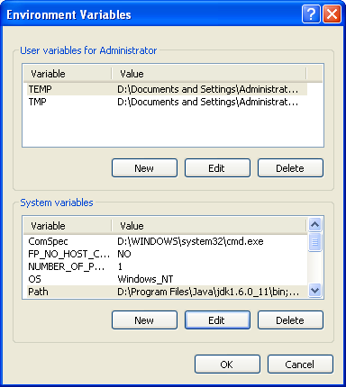
Java Basics
Setting the path.
  Step 3:
  Go to environment
  variables option

Slide 8
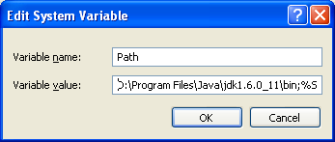
Setting the path.
  Step 4:
  Edit path and paste the
  bin path with the semicolon
  at the end.

Slide 9
Looping in Java
While Loop
  Syntax:
      intialization;
      While(condition)
      {
      statements to run while condition is true
      }
  Example :
      int i=0;
      While(i<10)
      {
      System.out.println(“Hello”);
      i++;
      }

